Slide 1
T29: Environment, Safety
Pedestrian dynamics
Alastair Shipman and Georgia Bateman

Slide 2
Introduction
How do you design an Olympic village to accommodate 100,000 people. What happens if 200,000 turn up?
How do you future proof Crossrail for the increasing population of London?
What do you do in the zombie apocalypse? What do other people do?

Slide 3
ILOs of this course
Define the topics of pedestrian and evacuation dynamics
Outline the main emergent properties of crowd behaviour
Employ the hydraulic model of evacuation
Outline the main theories of human behaviour in evacuations,
Recall and develop the different algorithms used for pedestrian dynamics simulation models.
Evaluate the design of experiments and data gathering

Slide 4
History
In the 50s:
Hankin, B.D. and R.A. Wright, Passenger Flow in Subways. Journal of the Operational Research Society
In the 70s and 80s:
Fruin, Pedestrian planning and design. 1st ed. 1971
Predtechenskii…
In the 90s:
Helbing
In the 2000s:
All sorts of rubbish
In the 10s:
All more sorts of rubbish.

Slide 5
Pedestrian dynamics models
Macro scale
Micro scale
Meso scale
Agent based
Fluid based
Cellular Automata
Network
Etc.

Slide 6
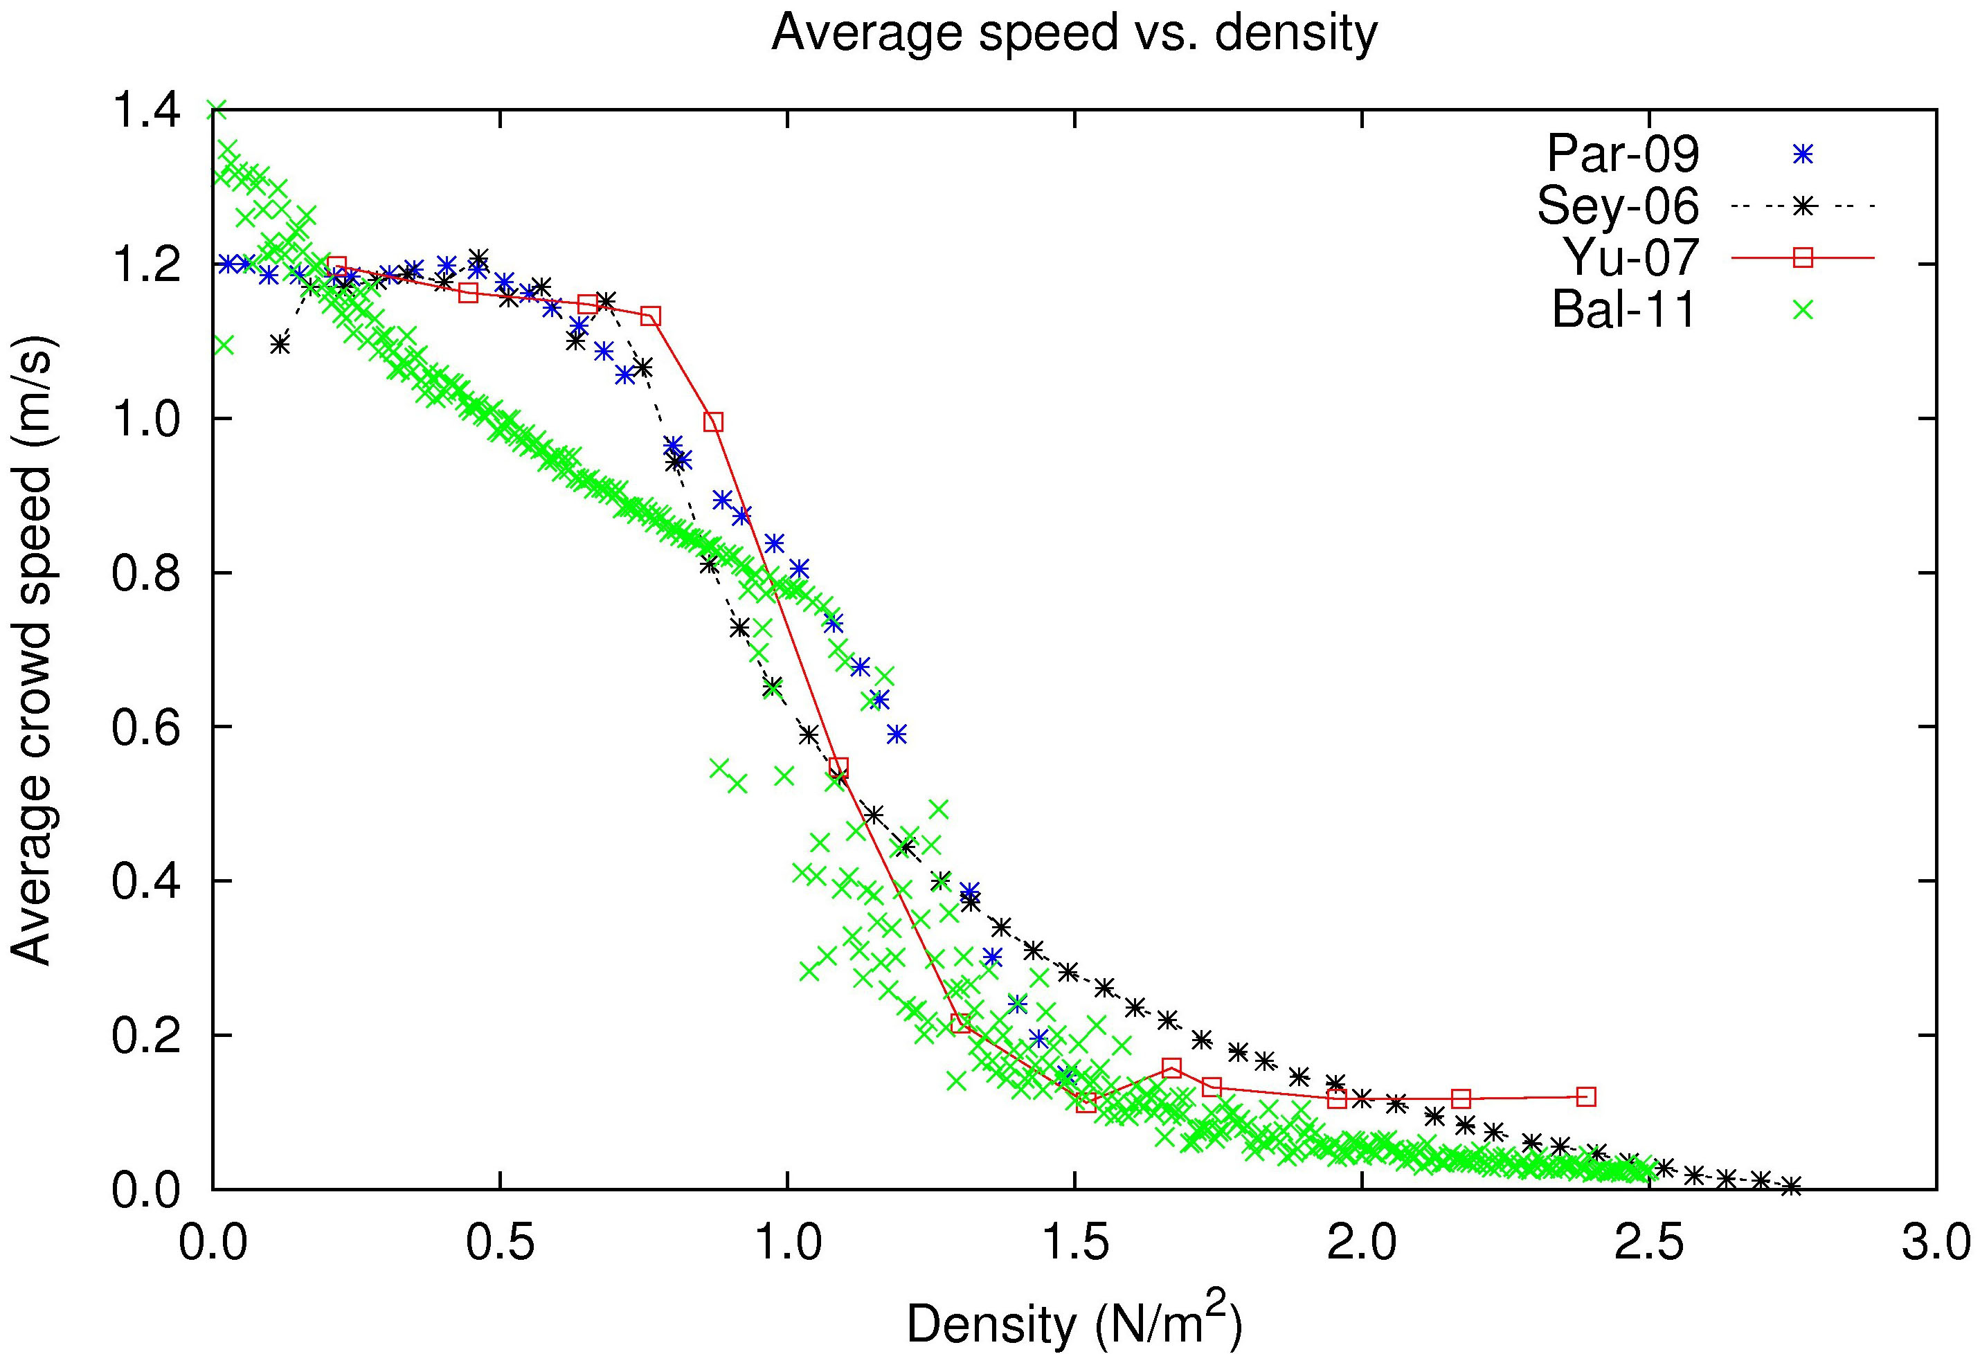
Pedestrian dynamics: fundamental diagrams
Speed vs Density

Slide 7
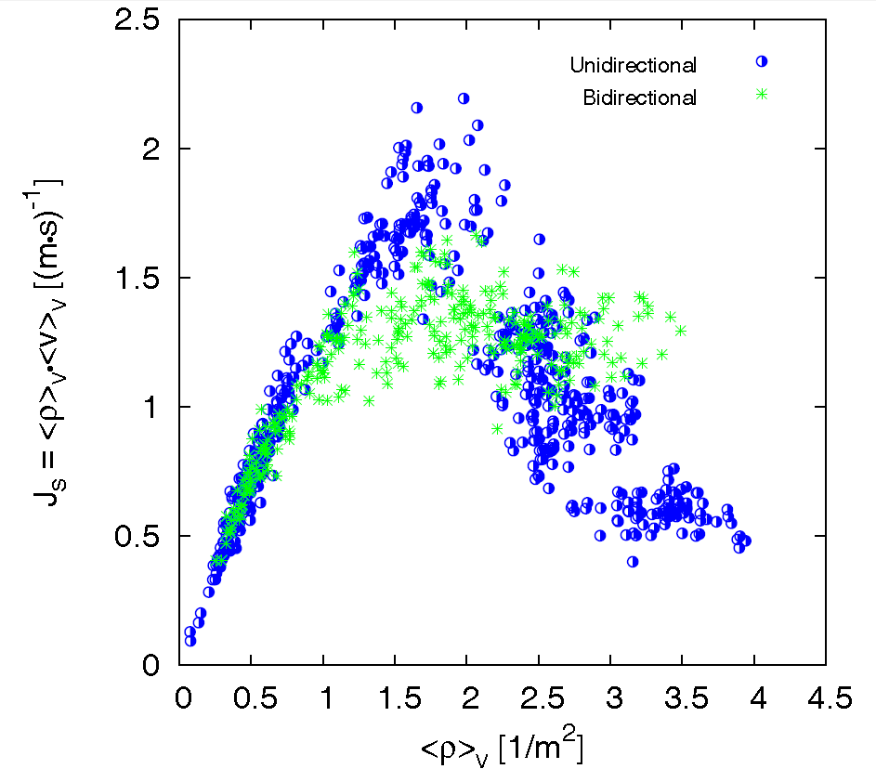
Pedestrian dynamics: fundamental diagrams
Flow vs Density

Slide 8
Hydraulic model: introduction
This is a micro scale model: it looks at individual buildings.
It treats people as discrete groups, not individuals.
Similar to fluid models, but simpler maths.
Based mostly on fundamental diagram

Slide 9
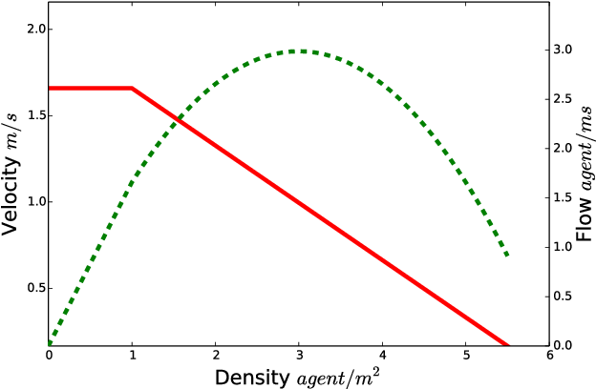
Hydraulic model: fundamental diagrams

Slide 10
Hydraulic model: introduction
Elements and transitions
Solve a quadratic in density either side of a transition
Use that density to solve for speed and flow rate.
That informs time taken for traversal
Finally, add up all the times taken to evacuate

Slide 11
Hydraulic model: introduction
Elements and transitions
Solve a quadratic in density either side of a transition
Use that density to solve for speed and flow rate.
That informs time taken for traversal
Finally, add up all the times taken to evacuate

Slide 12
Hydraulic model: introduction
Elements and transitions
Solve a quadratic in density either side of a transition
Use that density to solve for speed and flow rate.
That informs time taken for traversal
Finally, add up all the times taken to evacuate

Slide 13
Hydraulic model: introduction
Elements and transitions
Solve a quadratic in density either side of a transition
Use that density to solve for speed and flow rate.
That informs time taken for traversal
Finally, add up all the times taken to evacuate

Slide 14
Hydraulic model: introduction
Elements and transitions
Solve a quadratic in density either side of a transition
Use that density to solve for speed and flow rate.
That informs time taken for traversal
Finally, add up all the times taken to evacuate

Slide 15
Hydraulic model: introduction
Elements and transitions
Solve a quadratic in density either side of a transition
Use that density to solve for speed and flow rate.
That informs time taken for traversal
Finally, add up all the times taken to evacuate

Slide 16
Hydraulic model: equations
S=k-akD: constant for elements. A constant, k defined by element.
F= SDWe: We defined by element.
F= kD(a-kD)We: combining the above.
Fin=min(Fout, Fmax): limited at transition points.
Can use this to find out how long it takes to move through a building.

Slide 17
Hydraulic model: Example
50 people
1.5ppl/m^2
Door
Width =1.8m
Staircase
Length =3.3m
Width =1.8m
Corridor
Length =10m
Width =1.8m

Slide 18
Examples: videos
Insert massmotion, pathfinder, SIMULEX etc

Slide 19
So what do we need to know to properly model this?
Data analysis and generation methods
Simulation
Psychology
Physiology: step length, fitness levels, typical anatomy and morphology. Density estimations.
Learning and cognitive processes
Building design and codes

Slide 20
How can this help?
Influence new designs
Retrofit existing buildings
Support real-time decision making (especially in emergencies)

Slide 21
Workshop: build fundamental diagram
Rope circle: 2m^2
3-8 people

Slide 22
Workshop: Hydraulic model
Skempton building. How long does it take for this room to evacuate the building?
Assumptions:
Rest of the building is empty
All room occupants follow the same, shortest path
All occupants follow standard speed/flow/density relationships
45 minutes, work in groups, present answers for 15 minutes.

Slide 23
Mentimeter poll
The hydraulic model can accommodate different demographic characteristics: TRUE/FALSE
The hydraulic model is an agent based model: TRUE/FALSE
I want to look at the evacuation of a city, what type of model should I use: MACRO/MICRO/MESO

Slide 24
Intro to remainder of course
Flipped approach
Online lectures
We will be releasing videos on blackboard. You need to watch these before turning up to the class
Workshops
Hand-on learning and practice of lecture material
Mentimeter quizzes
They will cover the work done in the previous workshop, as well as the lectures you have watched.
They will form part of your coursework mark.

